Slide 1
How to do machine learning research
by Bill Freeman, Andrej Karpathy, Eamonn Keogh
Summarised by
Markus Heinonen, Aalto University
March 2025

Slide 2
http://people.csail.mit.edu/billf/publications/How_To_Do_Research.pdf
Bill Freeman, MIT
~90,000 citations

Slide 3
Please don’t tell me “it doesn’t work”. Of course it doesn’t work
What I want to hear instead is something like, “I’ve narrowed down the problem to step B. Until step A, you can see that it works, because you put in X and you get Y out, as we expect. You can see how it fails here at B. I’ve ruled out W and Z as the cause.”
Take things slowly. Verify your assumptions. Understand the thing, whatever it is–the program, the algorithm, or the proof. As you do experiments, only change one thing at a time, so you know what the outcome of the experiment means.

Slide 4
Slow down to speed up
I love to hear about progress when I meet with students, but note that I have a very general notion of progress. Progress can include: “I’ve shown why this doesn’t work”, “I’ve simplified the task to get it to start working.”, or “I spent the whole time reading because I know I have to understand this before I can make any progress.”
The weak student does exactly what the advisor has asked. But the advisor’s solution fails, and the student reports that failure.
The strong student starts doing what the advisor has asked, sees that it doesn’t work, looks around within some epsilon ball of the original proposal to find what does work, and reports that solution.

Slide 5
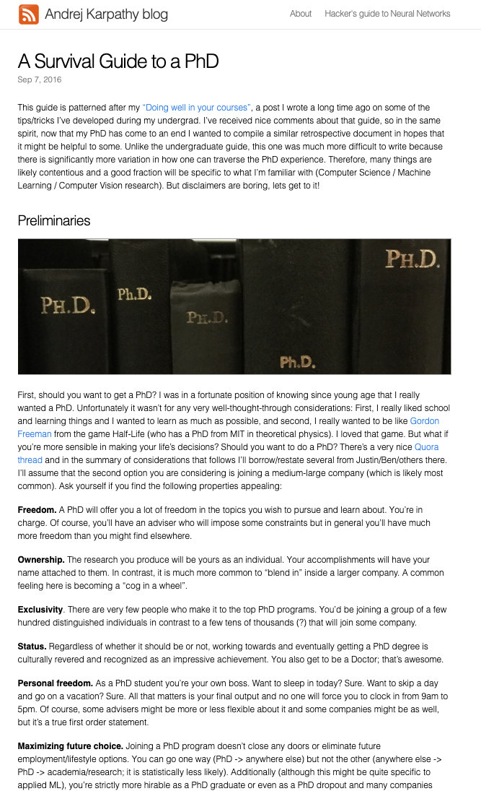
Andrej Karpathy, Tesla
~55,000 citations
http://karpathy.github.io/2016/09/07/phd/

Slide 6
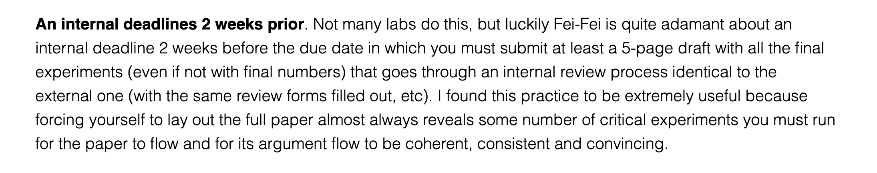
Finishing papers

Slide 7
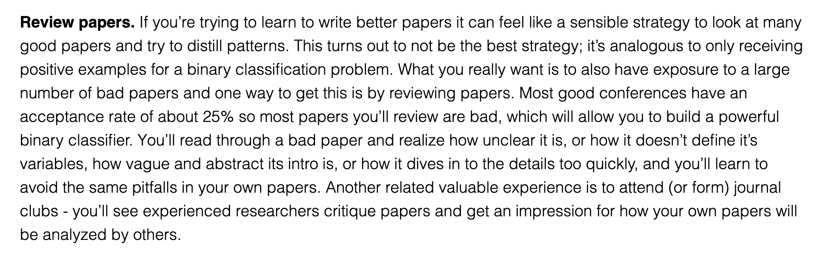
How to write good papers

Slide 8
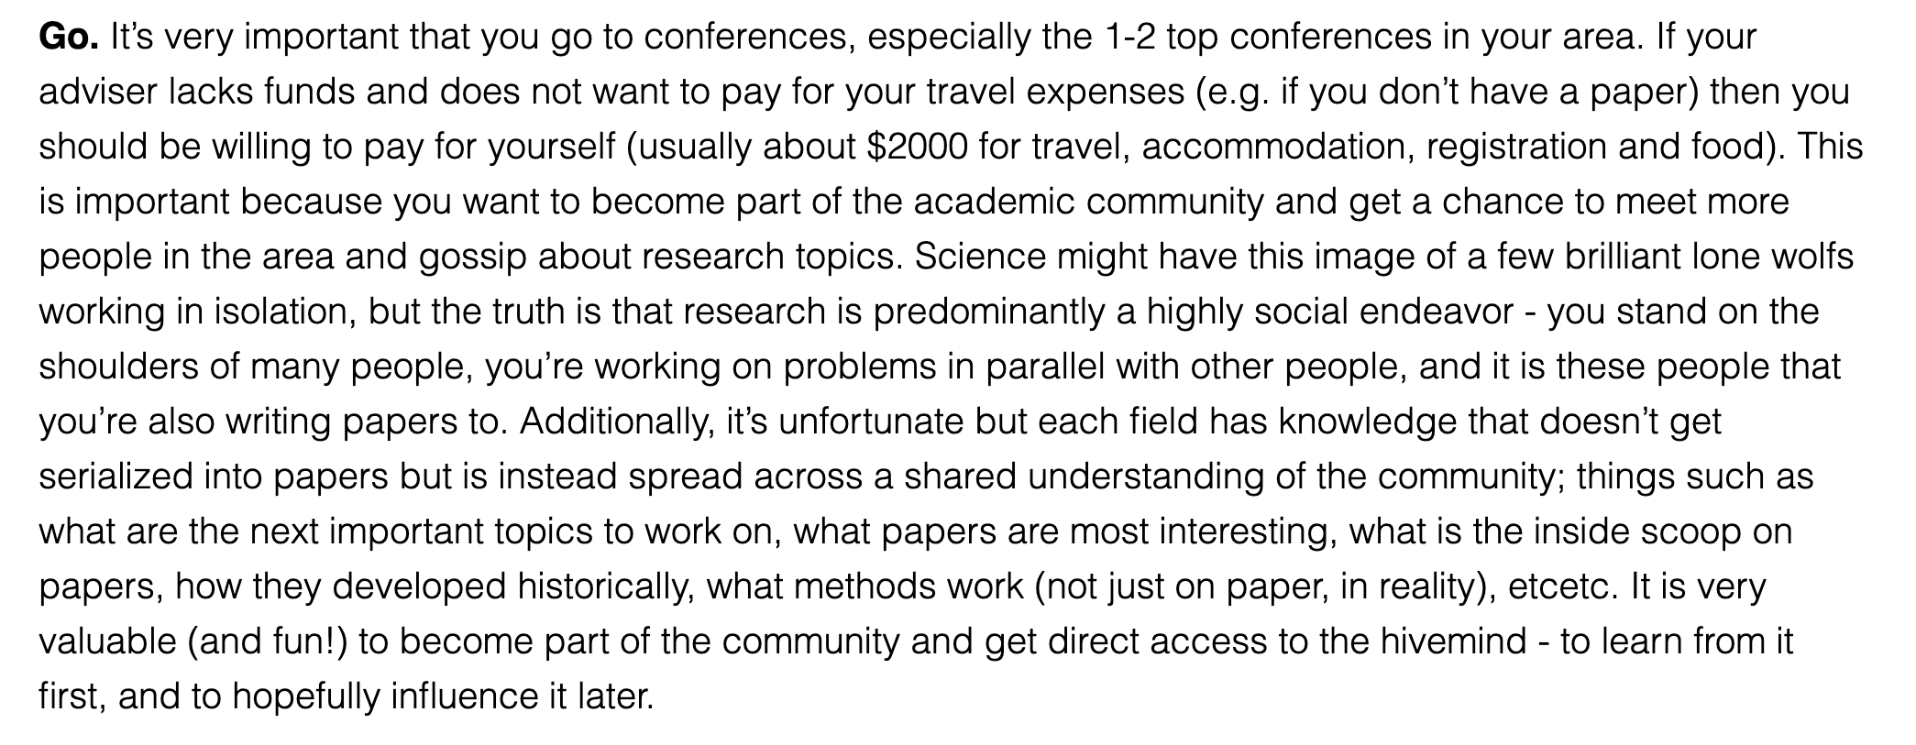
Conferences

Slide 9
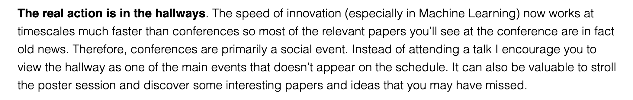
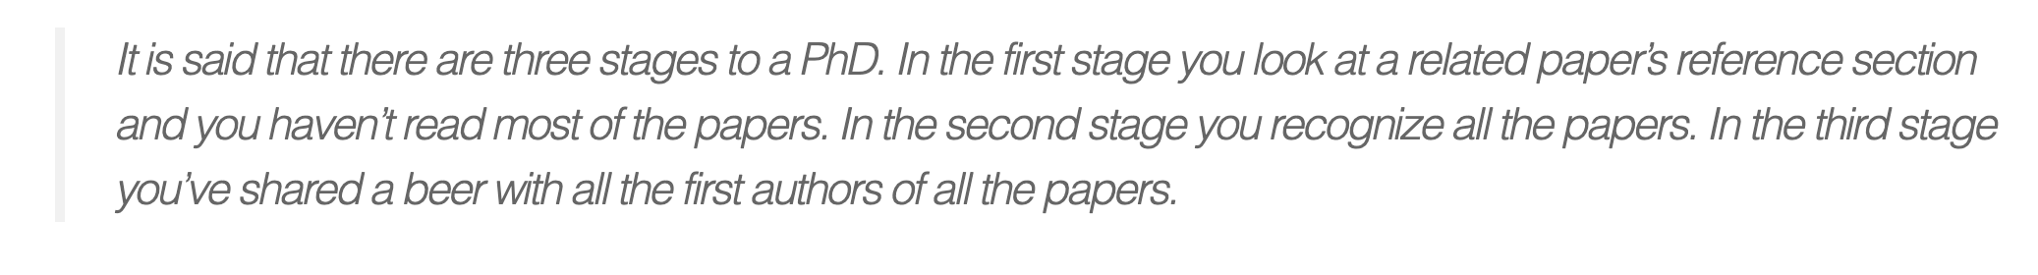
Conferences

Slide 10
http://www.cs.ucr.edu/~eamonn/Keogh_SIGKDD09_tutorial.pdf
Eamonn Keogh, UC
~55,000 citations

Slide 11
Finding research problems

Slide 12
Problem statement

Slide 13
First page as an anchor

Slide 14
Eliminate simple ideas first

Slide 15
Don’t make reviewers think!
👎
👍

Slide 16
👎
👍

Slide 17
Reproducibility

Slide 18
Use color

Slide 19
Too many digits

Slide 20
Be precise

Slide 21
Report performance distribution

Slide 22
Report performance distribution
👎
All of these hide information
This is ok, but still hides information

Slide 23
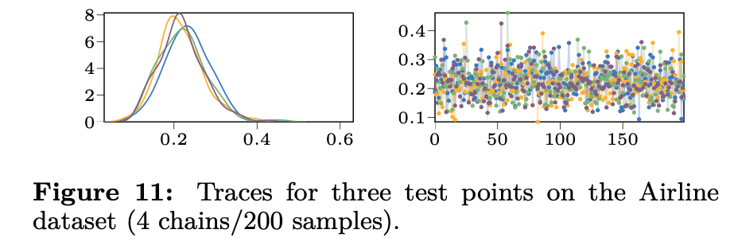
Show your distributions!
Show both of these
👍

Slide 24
My recommendations

Slide 25
Recognize sources of variability
Always give some variance of all metrics
At least six sources of variability
  Test distribution
  Function stochasticity
  Parameter posterior
    Parameter initialisations
    Hyperparameters
    Training samples
    Random seed
A good paper demonstrates how the model behaves wrt all sources
$$Ε_{x∼p\left(X_{test}\right)}f\left(x | θ,ε\right)p\left(θ | θ_{0}, γ, X_{train}, seed\right)$$

Slide 26
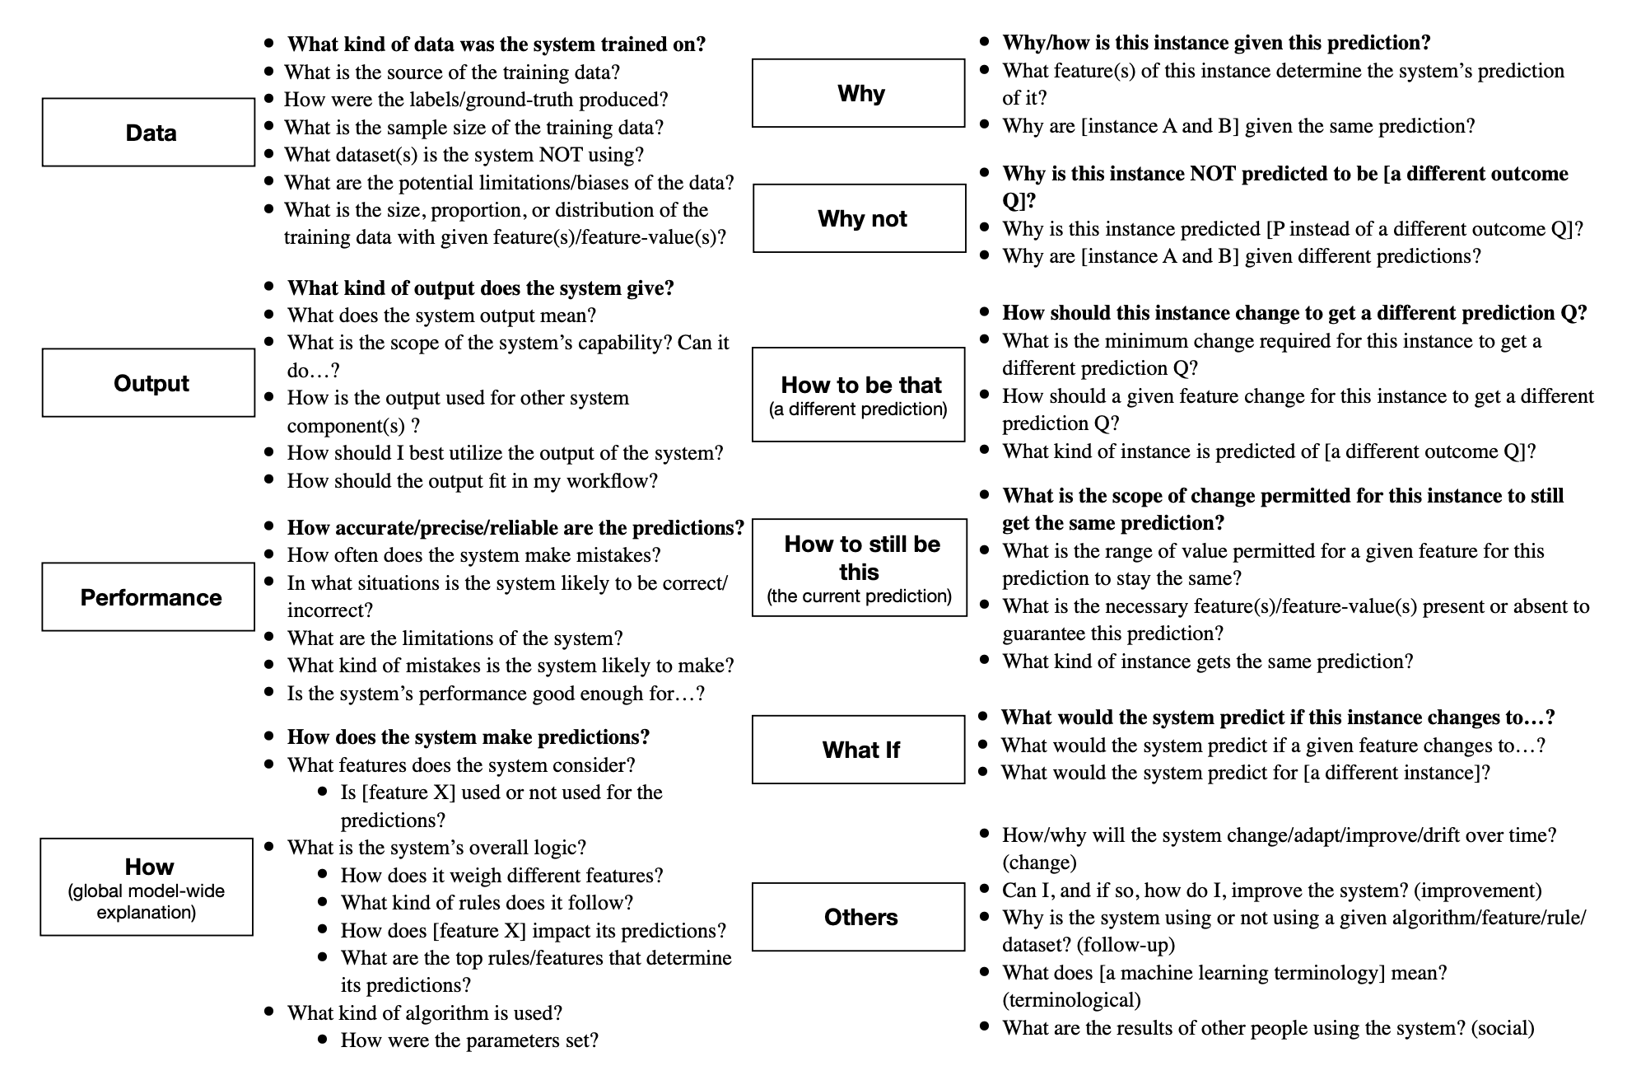
Do you understand your model?
.. does your audience?
.. do your reviewers?
🤔
Liao, Gruen, Miller. Questioning the AI: Informing Design Practices for Explainable AI User Experiences, 2020

Slide 27
Two scenarios
Students runs an experiment and gets great results, but doesn’t know why
Student runs an experiment and gets bad results, and doesn’t know why
Which one is better?
  Both are bad!

Slide 28
Standard for publications is high!

Slide 29
On being precise
Sloppy presentation implies that you don’t care about your work
  Typos, mistakes, poor illustrations, missing citations
Typos signal that you did not bother to proofread your paper
  Why should a reader read it either?
There can not be mistakes in math
  If you don’t understand the equations, why should the reader bother?

Slide 30
Giving talks
Don’t target your talk to experts of your domain
  They have already read your paper; they will cite you anyways
Target your talk to non-experts
  Conferences are a place to hear about new things
The audience has a limited mental budget
  The listener has to build a mental model of every equation
60% of people are visual learners
  Visualise all math: If you can’t, can the audience?
  Don’t make audience think
  Color your math
After 5 equations or symbols half the people will stop listening
  Is all of your math crucial for understanding?
  Can you replace math with figures?

Slide 31
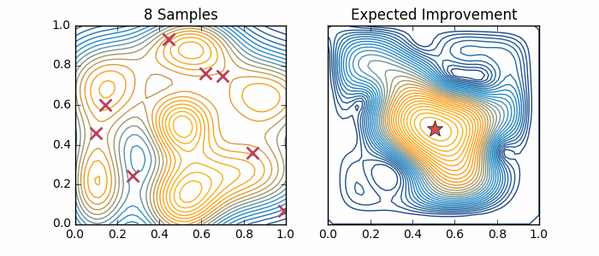
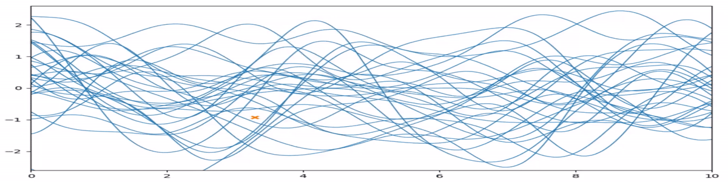
Animate your presentations!
The math of this slide can be almost understood with no math!
👍

Slide 32
Wide aspect ratio looks nicer
\documentclass[aspectratio=169]{beamer}
👍

Slide 33
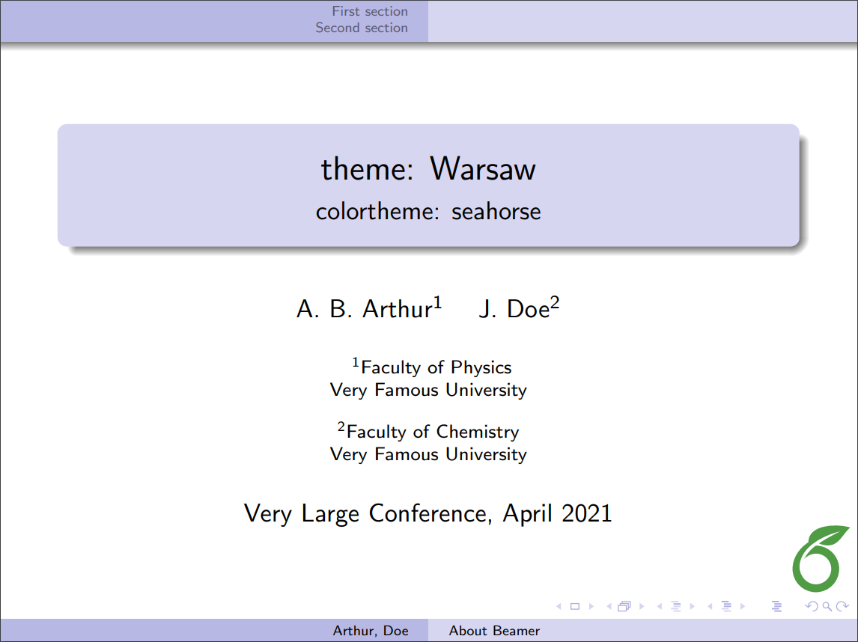
Remove unnecessary stuff

Slide 34
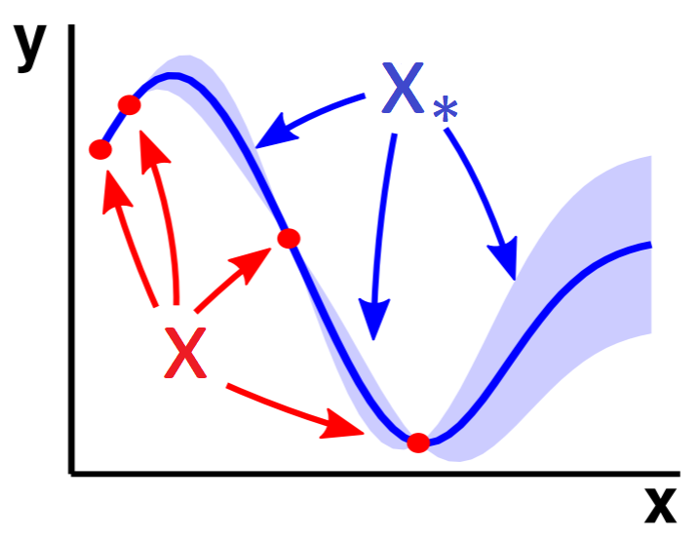
Annotate plots
Help the reader!
👍

Slide 35
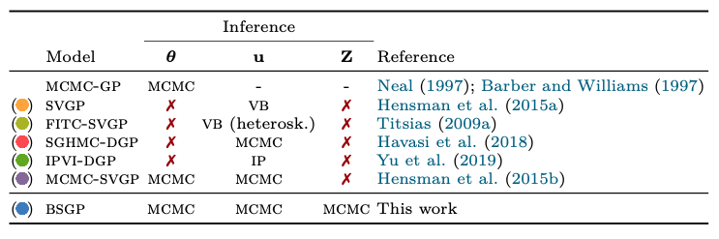
Include scope table
Define the context!
👍
(colors help a lot!)

Slide 36
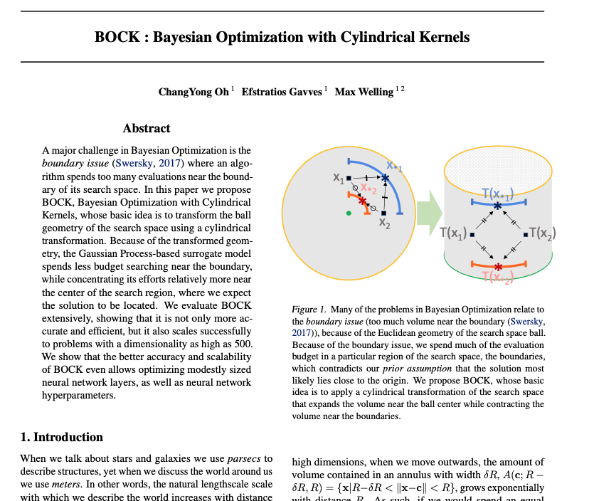
Use a first-page figure
(but what kind…)
👍

Slide 37
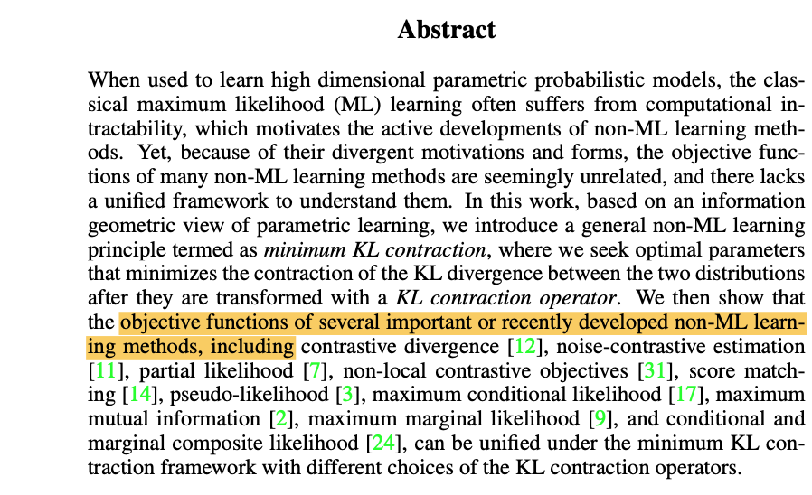
You can break article conventions
🤔
Citations in abstract, why not
Literature survey can come late
Math on second sentence is fine

Slide 38
Tips for paper structure
Title can be conclusive or descriptive
  Prefer interesting and thought provoking titles
Short introduction that establishes the problem (2 paragraphs)
  Keep to the main message
  Only include references that are relevant for your problem
First page figure that sells the message
Place “related works” section after results
Use lots of subheadings (the paragraph format is ideal)
Headings should be conclusions or questions

Slide 39
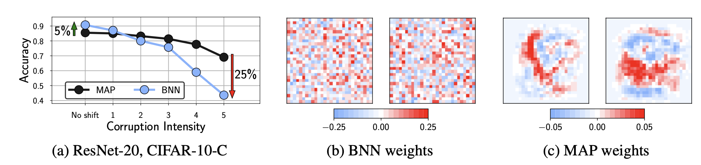
First figure
Always have an informative first figure that ideally
  Establishes the problem
  Describes the idea of the solution

Slide 40
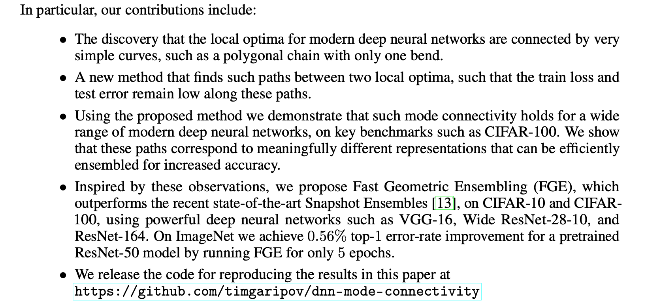
Bullet your contributions
(reviewers are asked to list them, don’t make them think)
Don’t forget this

Slide 41
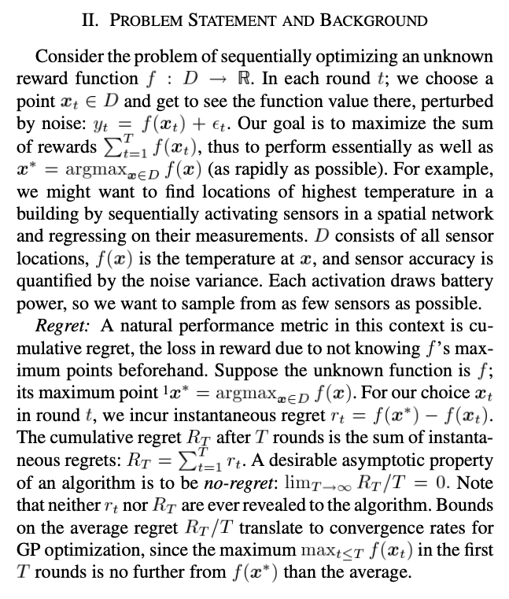
Define your problem
👍
Precise goal
Conceptualise
Define unknowns

Slide 42
Visualise the obvious
👍

Slide 43
High-level schematics
👍

Slide 44
Technical schematics: map your math
(also separate how model use differs between train/test)
👍

Slide 45
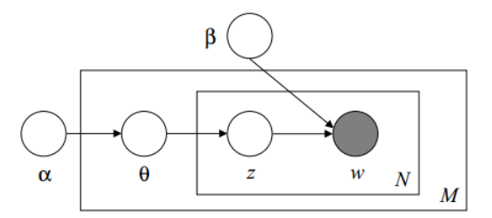
Are you probabilistic? Then do a plate diagram
👍

Slide 46
Clear result tables
\includepackage{booktabs}
👍
Eyes naturally compare things vertically, but can’t compare horizontally
Use color
(but be consistent)
(don’t forget variances!)

Slide 47
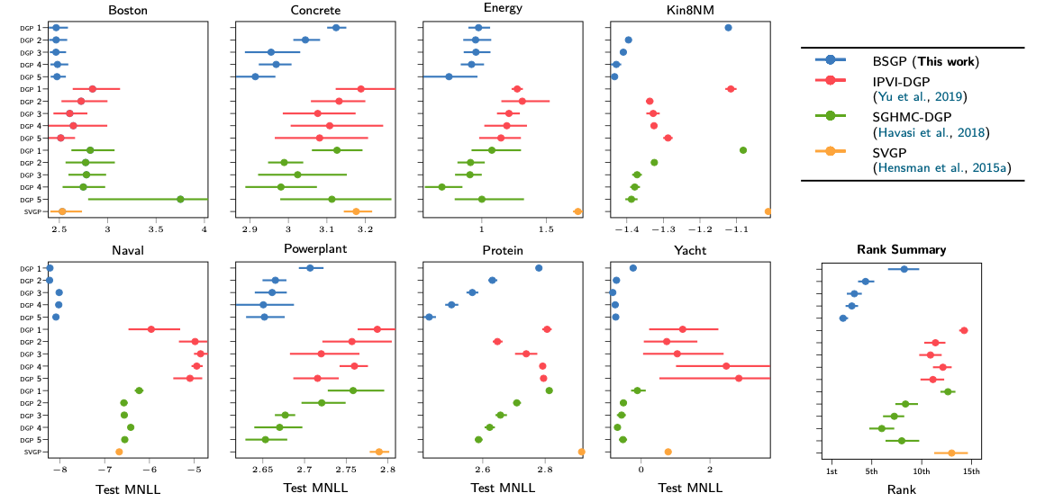
Presenting large comparisons
👍
Summarise!

Slide 48
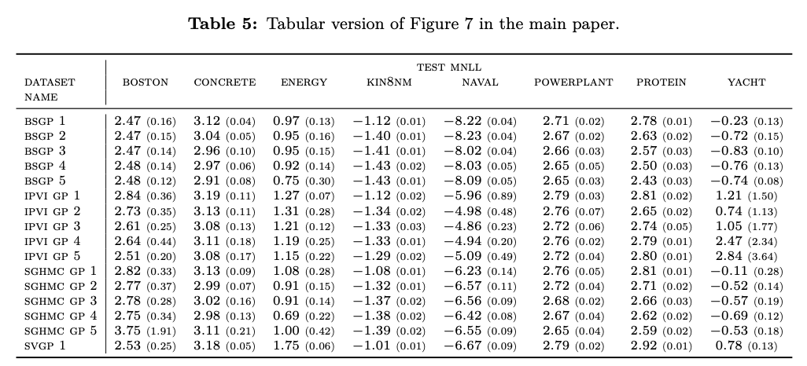
Presenting large comparisons
👍
Put tabular copy to appendix!
Std with smaller font 👍

Slide 49
Visualise intermediate fits
👍

Slide 50
Ablation studies
👍

Slide 51
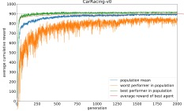
Learning curves over data / folds / ensembles / terms
👍

Slide 52
Include “dummy” baselines
👍
( too many digits! )

Slide 53
Parameter & feature tables
👍

Slide 54
Start every project with PCA / T-SNE / UMAP
👍

Slide 55
Visualise loss landscapes or posteriors
👍
https://arxiv.org/abs/1712.09913

Slide 56
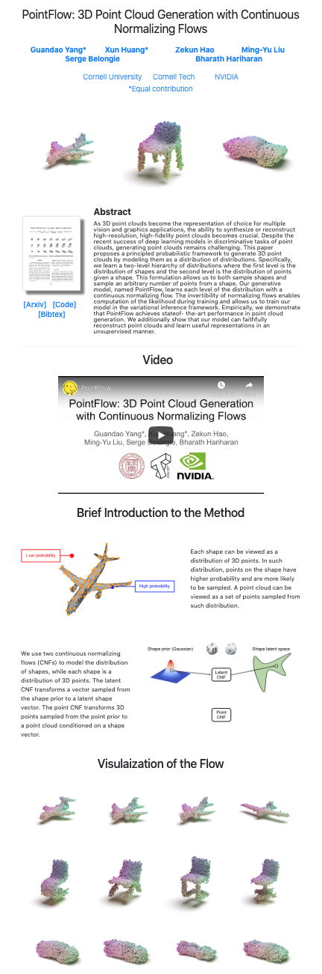
Build your brand
Have a twitter/blog/github/scholar/website
  Make sure collegues/journals/conferences/bigshots can find you online
Build a website for each paper
  Include code / examples / visualisations
  Arxiv is not enough
  Include a “1-click” demo
  Website increases impact and reach

Slide 57
On plotting
Use soft color (the “CN” colors in matplotlib)
  Don’t use “r/b/g/c/k” colors
  Use red-white-blue for two-sided colors
Save images with high dpi
  Trim all whitespace with imagemagick -trim
Scale figures to be readable with poor eyesight
  Make everything way bigger than you think!
  Decrease ‘figsize’ to scale the figure (use smallest figsize that looks good)
  Don’t adjust fonts manually
  All figure fonts need to be as big as caption font
Figures need to be self-contained and self-explanatory
  Does the figure work without caption? If not, simplify!
  Caption: give conclusion

Slide 58
On captions
🤔
Is the plot self-explanatory without the caption?
description
conclusion
Is the plot fully labelled?
👎

Slide 59
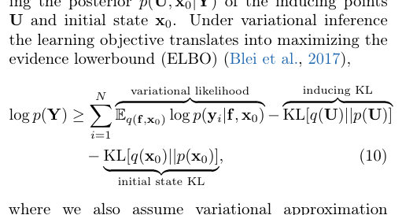
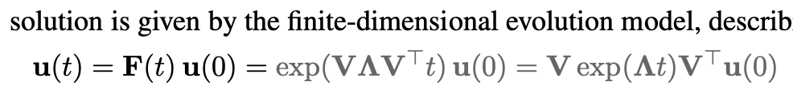
On Latex
👍
Try to keep to classic latex style
Basics
  Use booktabs for tables
  Use \resizebox to make tables exactly 1-column wide or 2-column wide
  Use natbib with \citep and \citet
  Color citations blue, eqrefs red
    \usepackage[usenames,dvipsnames]{xcolor}
    \usepackage[colorlinks=true,citecolor=MidnightBlue]{hyperref}
Math
  Use \align
  Don’t place line breaks around equations
  Don’t place whitespace around parenthesis (don’t use \left( if not needed)
  Use big parentheses a lot
  Use \underbrace a lot!
  Use macros, eg. \def\N{\mathcal{N}}
  Use color
Math presentation
  Prioritize readability and understandability
  Include full math and intermediate derivations in appendix

Slide 60
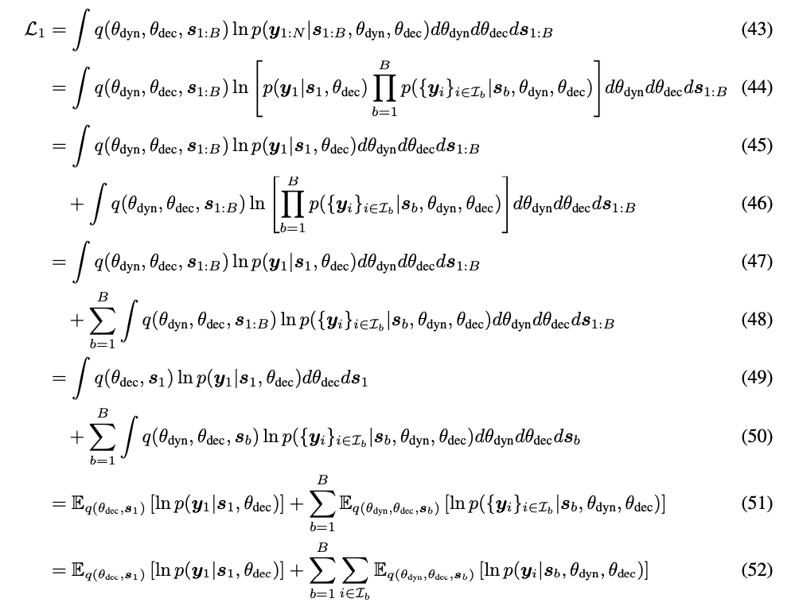
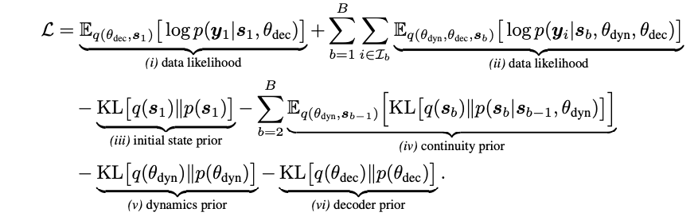
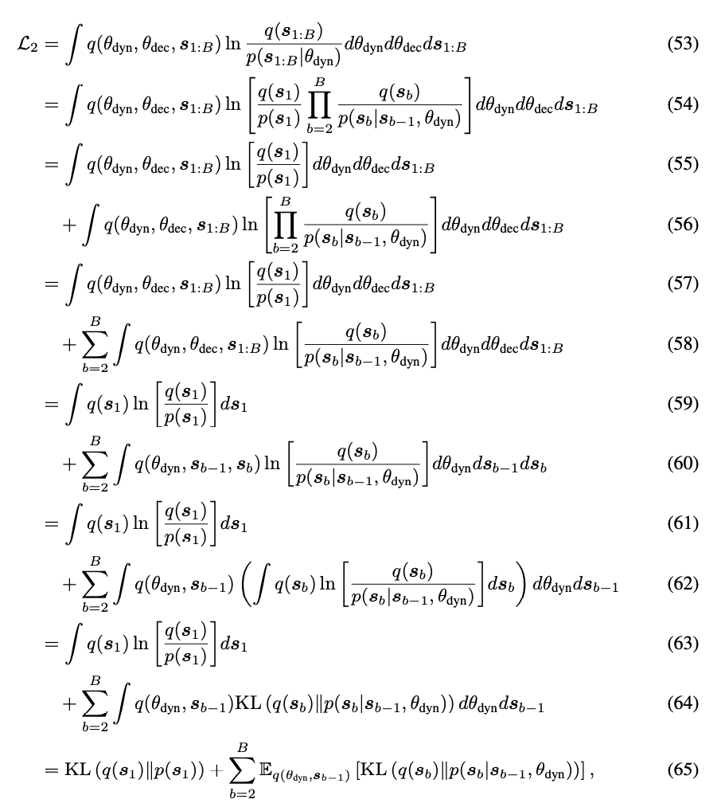
Complex math
Gist in main text, details in appendix
Annotate

Slide 61
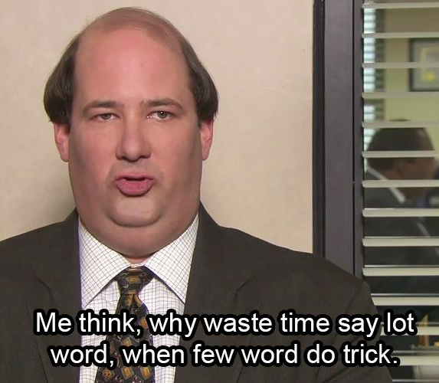
Remove unnecessary words that you don’t need in sentences.
because based on the fact that
for the purpose of
there were several subjects who completed
it is suggested that a relationship may exist
a total of n subjects
four different groups
the reason is because
The results showed that
https://www.sportsci.org/jour/9901/wghstyle.html

Slide 62
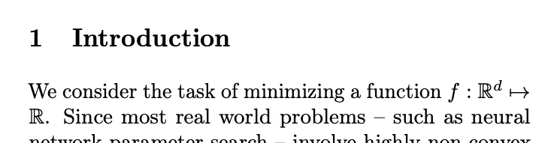
Go to the point
👍

Slide 63
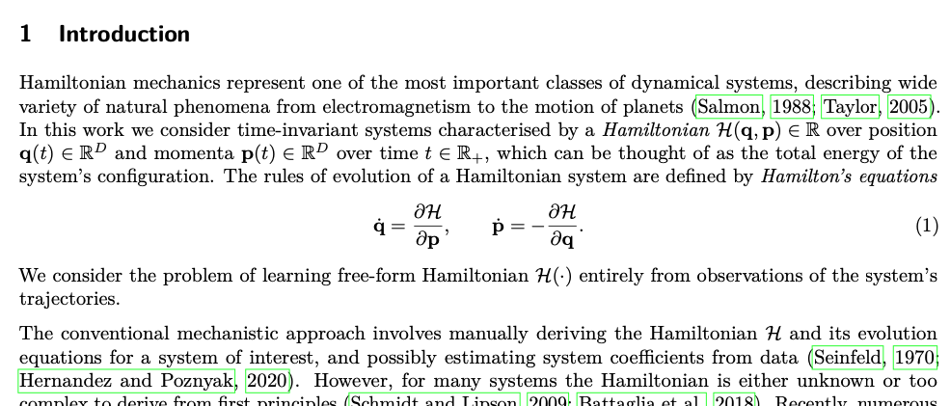
Go to the point
👍
Context
Setting
Problem

Slide 64
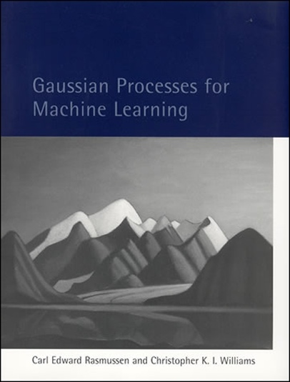
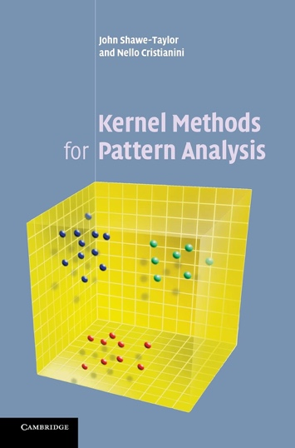
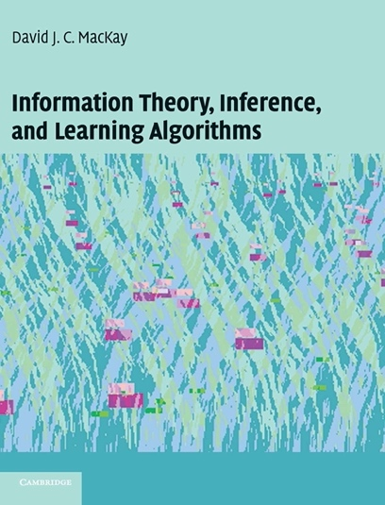
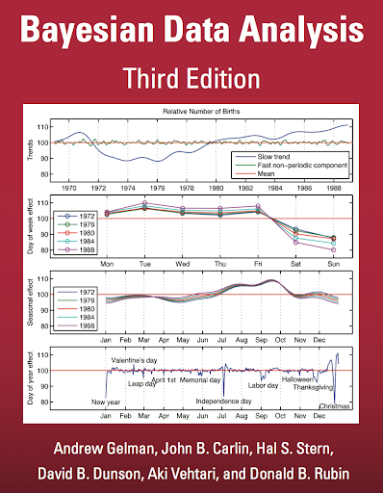
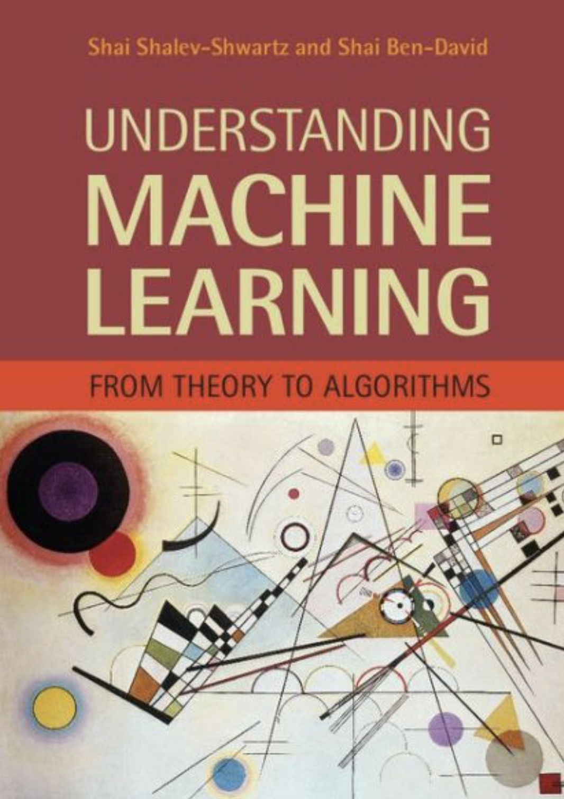


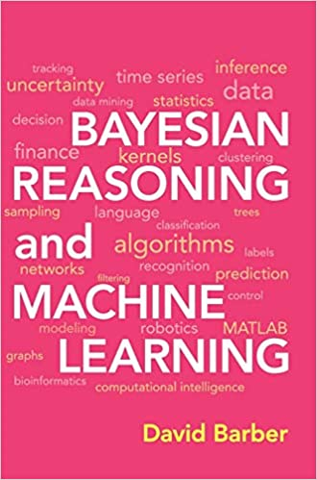
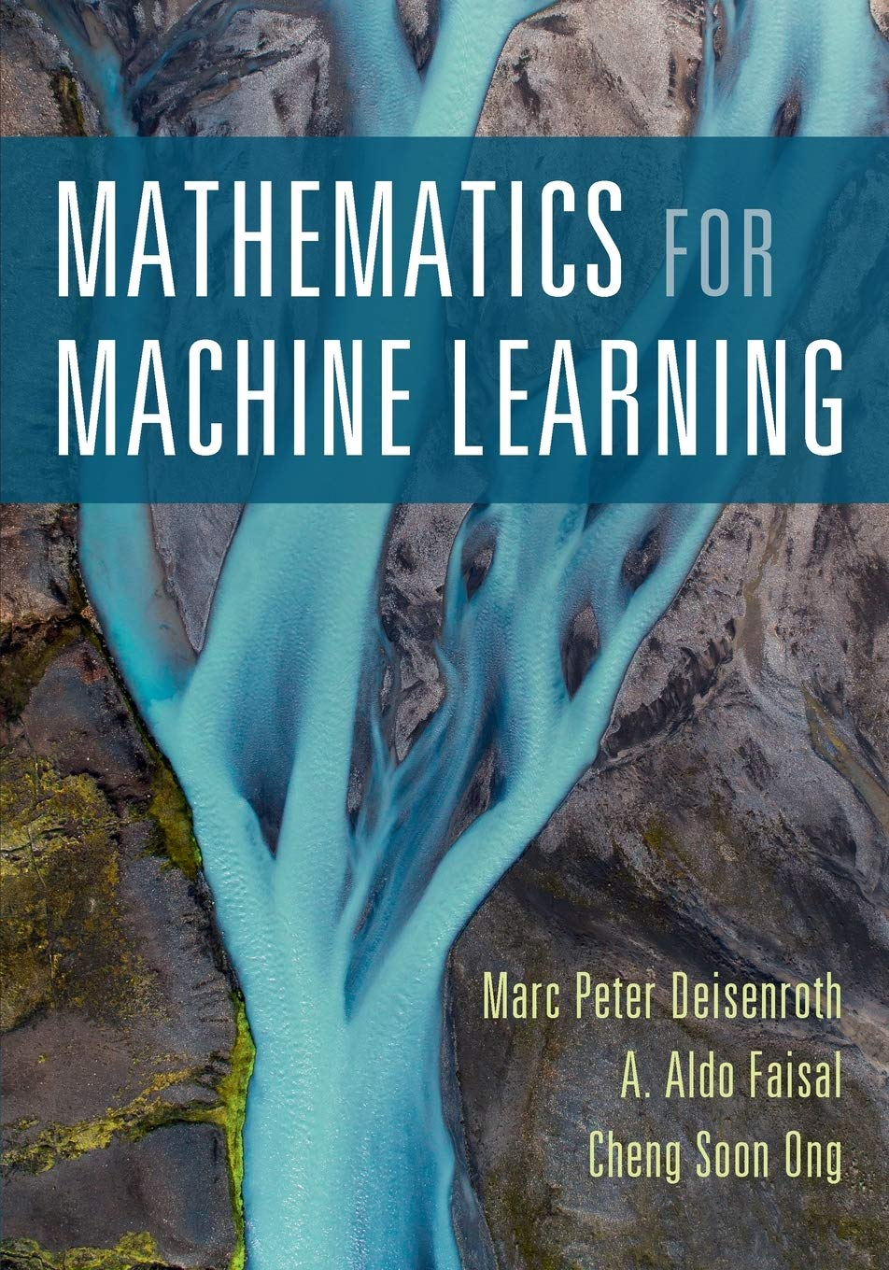

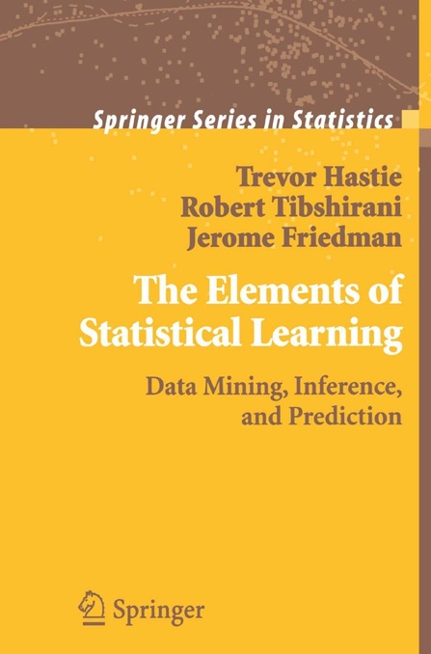

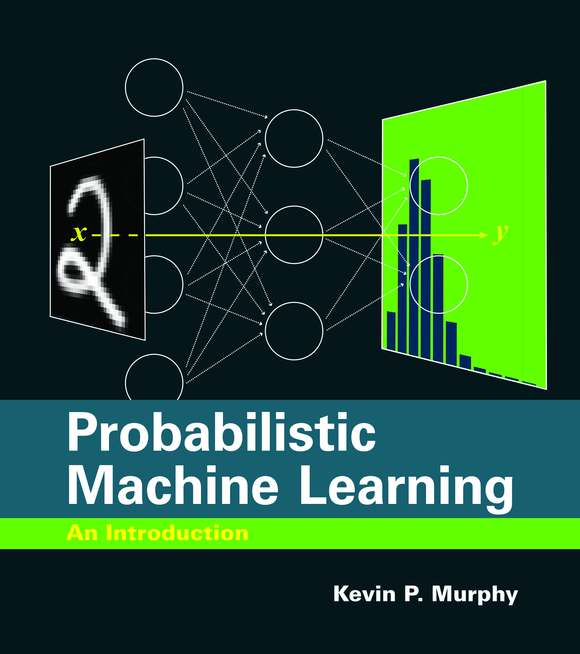
Read
1st year

